Slide 1
Video Game Strategy Inference Given Partial Observability using Discrete Probability Densities
Michael Kozak

Slide 2
Agenda
Topic | Duration
Thesis Overview | 3
Background | 10
StarCraft
Discrete Probability Densities
Strategy Representation
IRE and Strategy Inference | 10
Experimental Design | 5
Setup
Results
Conclusion | 2

Slide 3
Overview

Slide 4
Introduction
Master’s Thesis.
Part-time M.S. in Computer Science.
B.S. in CS from Drexel University ~8 years ago.
Research background in planning, autonomy, usability, and cognitive science.
Access to source code, documentation, and examples can be found at https://github.com/mikewkozak/IRE for anyone interested in reproducing these results.

Slide 5
Objectives
Develop an intent recognition engine that, given partial observability of enemy forces, can build a probabilistic representation of what their overall capabilities are.
Compare that “belief state” against known strategies to determine if the enemy is using a particular one.
Apply a counter-strategy and show improvement in win rate.

Slide 6
Who cares?
Intent recognition next step of autonomous operations as current planning systems reach high levels of maturity.
Partial observability is a reality of many operational domains.
Adversarial AI extends beyond physical into cyber domains.
Benefits any program with potential for dealing with adversarial AI OR where autonomy is expected to reason without complete knowledge.

Slide 7
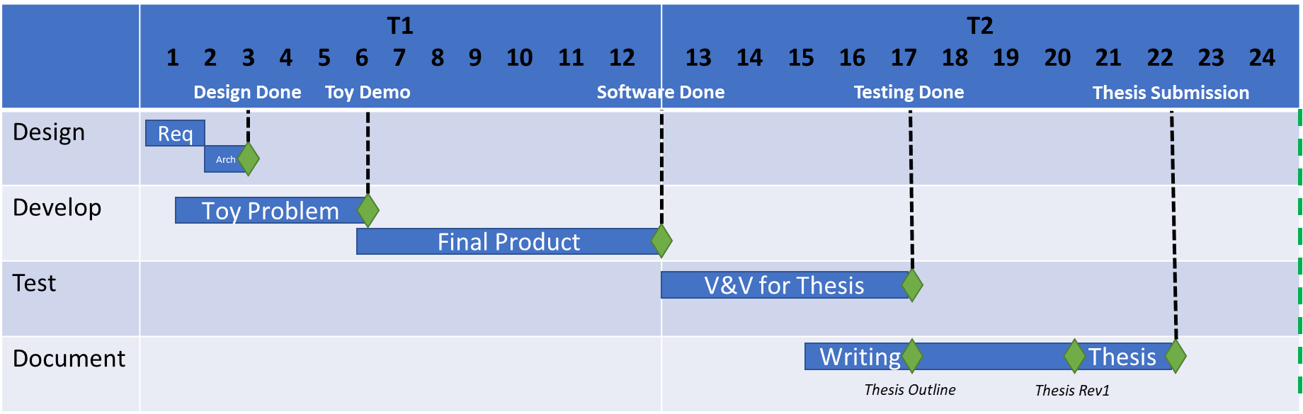
Schedule

Slide 8
Background

Slide 9
StarCraft

Slide 10
Starcraft for AI
Real-Time Strategy Game considered a frontier of AI research
Players can choose from 1 of 3 races with unique buildings, units, and upgrades.
Branching factor for unit decisions is between 10⁵⁰ - 10²⁰⁰
Players can only see what their units see, creating a partially observable enemy state
Notes:
Chess branching factor is 30^80

Slide 11
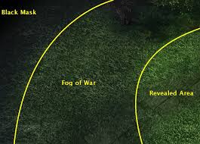
Fog of War
The revealed area is the union of all the sight ranges of all your units and buildings.
Previously viewed terrain and buildings within fog remain visible, but do not refresh state.
Never before viewed segments remains black until explored.

Slide 12
State of the Art
Yearly 1v1 AIIDE StarCraft AI competition (generally) between universities.
Player skill ranked by iCCup2 ladder as E through A+
The best AI bots ranked between D and D+ in 2013
AI rely on a wide range of different techniques:
Some of the most effective have hard-coded “rush” strategies
Some rely on micro-managing unit control or deep learning
“Nova” uses a tiered system of base management and squad control with relatively simple unit AI
Partial observability is often ignored in favor of reacting to the moment
Counter-strategies therefore rely on reacting rather to than predicting situations

Slide 13
Example Architectures

Slide 14
Discrete Probability Densities

Slide 15
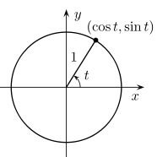
Probability Density Functions
In probability theory, a probability density function (PDF) is a way of describing the relative distribution of a continuous random variable within a bounded sample space (Robert Grover Brown, 2012).
PDFs have many uses, but one such use is in the localization of objects in space (K. Wendlandt, 2005).
Using only a signal intensity and bearing to a transmitter, a receiver can use repeated measurements to reduce the number of possible places the object could be until eventually it converges with very high probability on the exact location (S. Venkateswaran, 2013).

Slide 16
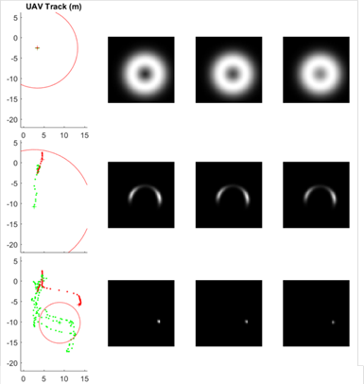
Discrete Probability Densities
A discrete probability density (DPD) map represents a PDF for the target from a given source of measurement.
These DPD maps are layered on top of each other, and overlapping areas represent higher probability locations for the target.
Over time and with additional observations, the actual location of the target will emerge with very little error as the most overlapped location additively rises above all other possibilities. (J. T. Isaacs, 2014)

Slide 17
Strategy Representation

Slide 18
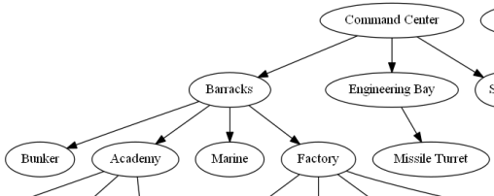
Tech Trees
In StarCraft every unit, building, and research upgrade has a fixed set of pre-requisites to enable production.
When we combine all these dependencies, it produces a single “tech tree” representing the races’ complete set of capabilities.
Stemming from this representation is the notion of “build order”. A build order is a unique set of ordered productions (building, unit, or upgrade) designed to produce certain units in certain quantities necessary to execute a specific strategy.

Slide 19

Example: Terran Tech Tree

Slide 20
Strategies as Subtrees
Strategies in StarCraft can generally be represented by a build order.
While there is nuance to the exact execution of that build order, such as building location placement, certain aspects remain fixed due to the strict dependencies between objects.
This build order induces a subtree of the races’ tech tree, consisting of only the nodes and edges required to achieve that series of productions.

Slide 21
Strategy Templating
Strategies exist as templated subgraphs representing the unique paths taken in upgrade choices
“Vulture Rush”
“Marine Rush”
Notes:
AI profiles with unique weights based on observed habits

Slide 22
Strategy Library
18 Strategies identified by research as most common “build orders”
Identified using clustering and quantitative analysis of the 2011 and 2012 AAIDE StarCraft AI competitions (Santiago Ontañon, 2013, 5 (4))
Lay out all strategies into a single supergraph known as “Strategy Space”

Slide 23
Categorizing Strategies
Universal constraints:
All units in StarCraft are either air or ground units
Each can either attack ground units, air units, or both.
Successful strategies in StarCraft either emphasize attacking as quickly as possible (“rushing”) or defending in the hopes of producing more advanced units.
Given these, we can treat each like a scalar value and rank any arbitrary strategy on that axis.
When combined, this creates a 3-dimensional vector “fingerprint” that uniquely identifies that strategy.
We can then use that vector to create points in space for every tree node.

Slide 24
“Strategy Space”
Ground Reliance
Defensive
Air Reliance
Anti-Air Reliance
Aggressive
Anti-Ground Reliance

Slide 25
IRE and Strategy Inference

Slide 26
Novel Approach
Combine Discrete Probability Density (DPD) process with Tech Trees to create “Strategy Space” of possible enemy strategies
Use observations to strengthen nodes/edges of strategy trees with an additive effect
Over time, the highest peaks will identify regions in “Strategy Space” where the enemy is most concentrated
While strategies are still being formed, IRE can act based on what strategies are currently most dominant, making it flexible to change.

Slide 27
Requirements
Blueforce – Player or Allied army
Redforce – hostile player
Capability - unit, building, or upgrade
Research – upgrades of unit or building capabilities purchased through an already built building
Strategy – A discrete collection of Capabilities in particular ratios designed to gain dominance over an opposing player with a bias towards land, hybrid, or air combat
ID | Requirement | Test Method
01 | The system shall represent the relationships and dependencies between units, buildings, and upgrades | Visual
02 | The system shall, given a Capability, determine what must be built or researched and what could be built or researched relative to other units, buildings, and upgrades | Automated
03 | The system shall, given a partial view of an enemy base, determine what must be built or researched and what could be built or researched relative to other units, buildings, and upgrades | Automated
04 | The system shall maintain a set of coarse strategies based on common play styles | Visual
05 | The system, given a representation of redforce Capabilities, suggest a strategy that the redforce is using | Automated
06 | The system shall, given multiple of a Capability detected, adjust the probability of each possible strategy | Automated
07 | The system shall, given ground truth and a predicted strategy, update the probabilities for the strategy based on Capability overlap | Automated

Slide 28
Risks/Mitigation
Risk | Mitigation
Strategies don’t map easily to selected coordinate axes | Place unusual strategies in region that results in “common” counter-strategy
Data collect proves too time consuming due to length of games | Professor (Dr. Santiago Ontañón) has tower computer I can use to automate testing
Win rate does not improve | N/A – may require better learning to be more effective
Success would demonstrate the benefits of strategy inference in partial observability and provide a software “nugget” for winning adversarial AI programs

Slide 29
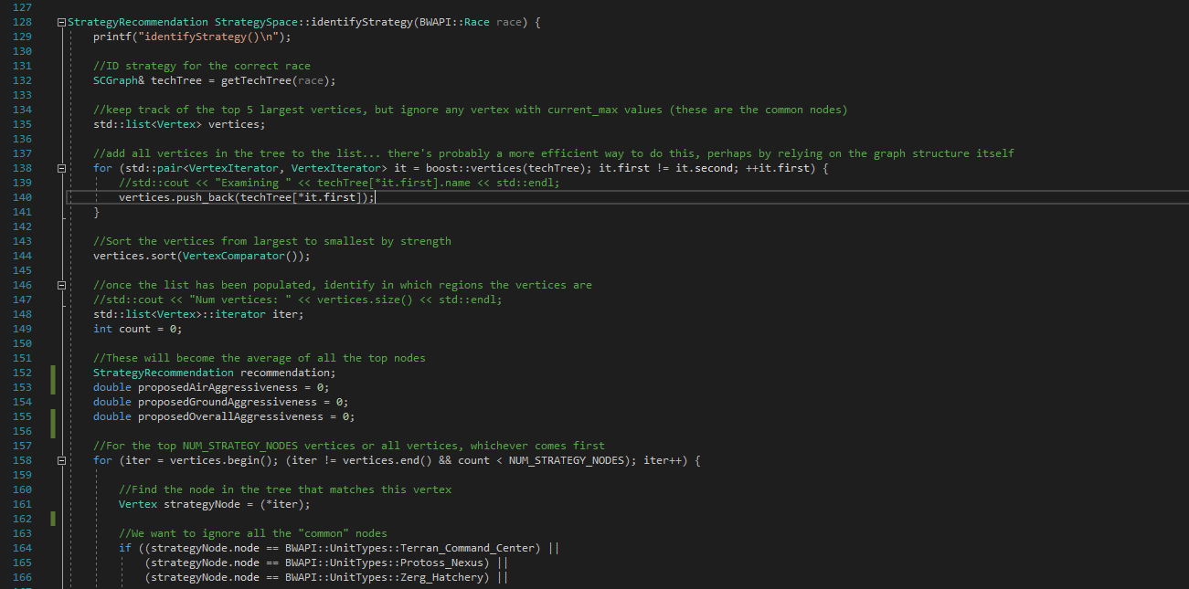
Coding Standards

Slide 30

Use Case Diagram
StarCraft
BWAPI
NOVA
Intent Recognition Engine (IRE)
ID Enemy Strategy
Strategies
Propose Counter-Strategy
Evaluator
Read and Write Strategies

Slide 31
Architecture
Strategy Reader
DOT Files
Test Driver
Strategies
Strategy Space
Game Interface
(BWAPI)
Nova AI Module
Tech Tree Manager
Utils
StarCraft
Tech Tree Manager
(I) Tech Tree Manager(s)

Slide 32
Strategy Space Convergence
As observations are made in strategy space, they will converge on which strategy is being used.
This also allows early counter-strategies as observations result in the enemy trending into “aggressive”, “defensive”, “ground”, and “air” quadrants without waiting to see the full enemy strategy.

Slide 33
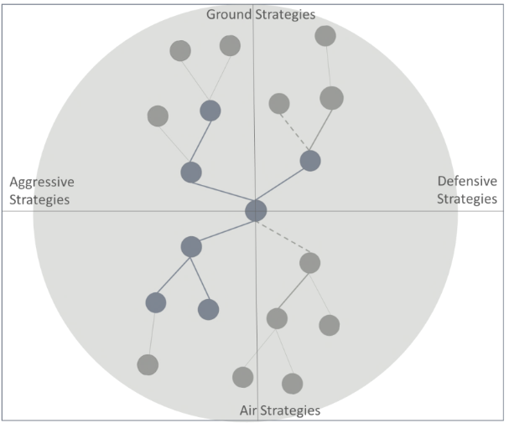
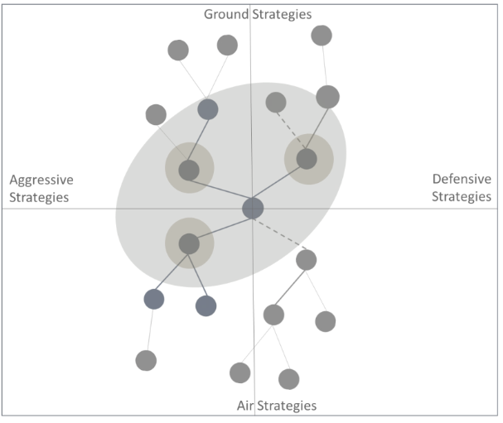
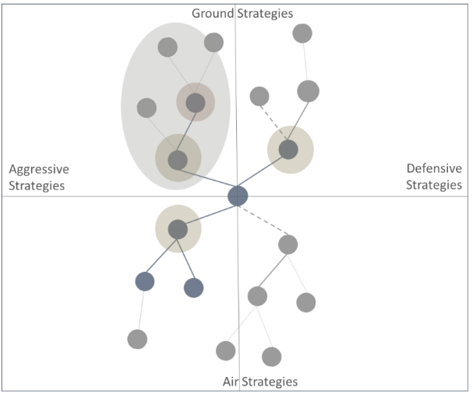
Strategy Space Convergence
The most observed nodes’ positions are averaged to become a measurement of enemy strategy.
IRE biases NOVA production to emphasize effective counter-units based on these numbers.

Slide 34
Experimental Design

Slide 35
Measure of Success
Test Methods:
Perform 300 matches using NOVA and 300 matches using NOVA + IRE
Enemy race set to “Random”
Map set to AIIDE approved “Benzene” competitive 1v1 map
Timeout of 100,000 “frames” to protect against stuck conditions (a timeout was counted as a loss)
Fix NOVA starting strategy to BBS (Barracks, Bunker, Supply Depot)
BBS is Nova’s most effective strategy in terms of win rate
NOVA can be configured to select a random strategy but not all are fully implemented
Target Metrics:
Compare win/loss ratio of base NOVA and inference NOVA
NOVA already wins against standard AI at ~80-90%, so I don’t expect a significant improvement
Break out W/L ratio by enemy race to check for variance
Measure accuracy of predictions

Slide 36
Results – Win Rate
The overall win rate was 79.92% with NOVA and 79.2% with IRE
IRE showed an improvement in win rate over NOVA against the Zerg, but a decrease in win rate across other races.
Games that timed out were not counted

Slide 37
Results – Predictive Accuracy
The first 100 games were evaluated for predictive accuracy
Rules:
If a game ended before a single offensive enemy unit was built, it was thrown out
If a game timed out with no winner, it was thrown out
A prediction was marked as “correct” if a matching strategy appeared in the top 3 strategies identified
A prediction was marked wrong in all other instances
Because nearly all games ended within the first few minutes, some strategies were never predicted due to requiring late-game units
Game results were manually examined for accuracy

Slide 38
Results – Predictive Accuracy
Tally (First 100 games):
61 valid games recorded
32 ended too soon (30 of which were superficially correct)
7 timed out
58 correct
3 wrong
Overall Accuracy: 95%

Slide 39
Conclusion

Slide 40
Future Work
There is clear room for growth and improvement due to the limited scope of IRE’s development. Future work could include:
A deep dive into counter-strategies to reveal where a targeted response best.
Probabilistic links could be added to nodes in each strategy and strengthened whenever one of the two nodes is observed.
IRE could use ground-truth observations at the end of each game to evaluate the links in the selected strategy and updating it based on what actually occurred.
Similarly, IRE could build entirely new strategies autonomously by creating a strategy tree from the actual assets created in the game.
More effective individual units would improve IRE’s win rate without having any negative impact on its predictive accuracy.

Slide 41
Conclusion
IRE proves there is applicability in using geolocation techniques to perform higher level strategy inference
More work can be done to boost effectiveness
Partial observability will continue to be a hot-button issue for autonomy research
Overall an excellent opportunity to explore this topic space

Slide 43
Sample Game Log
==========================================================================
NEW GAME
==========================================================================
Search and Destroy activated!
Enemy Units:
Protoss_Probe ID: 142 HP: 0 <other probes omitted for space>
B: Protoss_Nexus ID: 14 HP: 0
Protoss_Zealot ID: 145 HP: 0
B: Protoss_Pylon ID: 143 HP: 0
B: Protoss_Gateway ID: 140 HP: 0
B: Protoss_Pylon ID: 132 HP: 0
B: Protoss_Gateway ID: 135 HP: 0
Predicted Strategies: Gateway-Two_Gates, Gateway-Fast_DT, Gateway-Templar, Gateway-Speedzeal, Gateway-Corsair,
Frames: 9891 winner: 1 enemy: Protoss startPosition (400,3032) myKillScore: 1600 enemyKillScore: 0 EvaluationLastState: 1 map: (2)Benzene.scx

Slide 44
Tables

Slide 45
References
Alberto Uriarte, S. O. (2014). Game-Tree Search over High-Level Game States in RTS Games. Retrieved from AAIDE: http://nova.wolfwork.com
Champandard, A. (2014, August 12). Monte-Carlo Tree Search in TOTAL WAR: ROME II’s Campaign AI. Retrieved from Ai Game Dev: http://aigamedev.com/open/coverage/mcts-rome-ii/
He He, J. B.-G. (2016). Opponent Modeling in Deep Reinforcement Learning. arXiv:1609.05559.
J. T. Isaacs, e. a. (2014). "GPS-optimal micro air vehicle navigation in degraded environments". American Control Conference (pp. pp. 1864-1871). Portland, OR: IEEE.
K. Wendlandt, M. B. (2005). "Indoor localization with probability density functions based on Bluetooth". IEEE 16th International Symposium on Personal, Indoor and Mobile Radio Communications, Berlin, pp. 2040-2044 Vol. 3.
Laviers, K. e. (2009). Exploiting Early Intent Recognition for Competitive Advantage. Springfield, VA: KNEXUS RESEARCH CORP.
Robert Grover Brown, P. Y. (2012). EXPECTATION, AVERAGES, AND CHARACTERISTIC FUNCTION. In Introduction to Random Signals and Applied Kalman Filtering (pp. 13-18). John Wiley & Sons, Inc.
S. Venkateswaran, e. a. (2013). "RF source-seeking by a micro aerial vehicle using rotation-based angle of arrival estimates". American Control Conference (pp. pp. 2581-2587). Washington, DC: IEEE.
Santiago Ontañon, G. S. (2013, 5 (4)). A Survey of Real-Time Strategy Game AI Research and Competition in StarCraft. IEEE Transactions on Computational Intelligence and AI in games, IEEE Computational Intelligence Society, pp.1-19.
Uriarte, A. (2017). Adversarial Search and Spatial Reasoning in Real Time Strategy Games. Philadelphia: Drexel University.

Slide 46
Schedule
 | T1 1 2 3 4 5 6 7 8 9 10 11 12 | T2 13 14 15 16 17 18 19 20 21 22 23 24
Design
Develop
Test
Document
Design Done
Toy Demo
Software Done
Testing Done
Thesis Submission
Req
Arch
Toy Problem
Final Product
V&V for Thesis
Writing Thesis
Thesis Outline
Thesis Rev1

Slide 47
Strategies - Terran
Name | A vs AA | G vs AG | Atk vs Def
Bio (marines/medics) | -0.25 | 0.75 | 1
Rax_fe (second base) | 0 | 0 | -1
Two_facto(tanks) | 0 | 1 | 0.5
Vultures | 0 | 1 | 0.75
Air(wraiths) | 0.75 | -0.5 | 0.25
drop | 0.25 | 0.25 | -0.25

Slide 48
Strategies - Protoss
Name | A vs AA | G vs AG | Aggressive vs Def
Two_gates (zealots) | 0 | 1 | 1
fast_dt (dark templars) | -0.25 | 0 | 0
Templar | -0.5 | 0 | 0.5
Speedzeal (zealots+upgrades) | 0 | 1 | 0.75
Corsair | -1 | 0 | -0.75
Nony (dragoons) | 0 | 0 | 0.5
Reaver_drop | 0.25 | 0 | -0.25

Slide 49
Strategies - Zerg
Name | A vs AA | G vs AG | Atk vs Def
Speedlings (zerlings) | 0 | 1 | 1
Fast_mutas (mutalisks) | 1 | -1 | 0.25
Mutas (expand+mutas) | 0.75 | -0.75 | -0.25
Lurkers | 0 | 0 | -0.25
Hydras | -0.25 | 1 | 0.75

